Slide 1
Introduction to Music Appreciation
Kenny Lim

Slide 2


How often do you listen to music?
ⓘ
Click Present with Slido or install our Chrome extension to activate this poll while presenting.
Notes:
📣 This is Slido interaction slide, please don't delete it. ✅ Click on 'Present with Slido' and the poll will launch automatically when you get to this slide.

Slide 3

What type of music do you listen to?
ⓘ
Click Present with Slido or install our Chrome extension to activate this poll while presenting.
Notes:
📣 This is Slido interaction slide, please don't delete it. ✅ Click on 'Present with Slido' and the poll will launch automatically when you get to this slide.

Slide 4
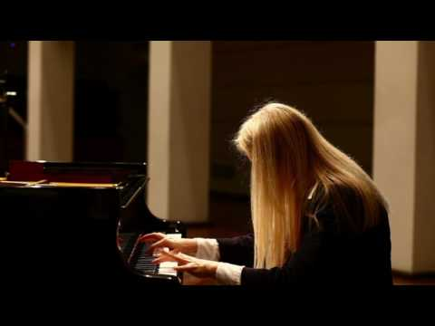
What do you hear?
Notes:
What do you hear?

Slide 5
What did you hear in the music?
ⓘ
Click Present with Slido or install our Chrome extension to activate this poll while presenting.
Notes:
📣 This is Slido interaction slide, please don't delete it. ✅ Click on 'Present with Slido' and the poll will launch automatically when you get to this slide.

Slide 6
What is this course about?

Slide 7
Elements of Music
Q: What is sound?
A: “Sound begins with the vibration of an object.”
Notes:
- So today we will be talking about Elements of music, anyone knows what does elements mean?
- ELEMENT: (Noun) An essential or characteristic part of something abstract.
- Music is an abstract art, you cannot see it, touch it; but you know it’s there, why?
- So when we are listening to music, what properties do we listen to?
- “Music is part of this world of sound, an art based on the organization of sounds in time. We distinguish music from other sounds by recognizing the four main properties of musical sounds: Pitch, dynamics (loudness or softness), tone color, and duration.”

Slide 8
Elements of Music
Pitch
Dynamics
Time in music

Slide 9
Pitch
• Pitch is the relative highness or lowness we hear in a sound.
• The pitch of a sound is determined by the frequency of its vibration.
Notes:
- The first properties we will be looking at today is Pitch.
- Pitch is the relative highness or lowness we hear in a sound, in western music pitch are separated in to 7 main pitches, can anyone tell me what these pitch are? Or sing them.
- Great, so the pitch of a sound is determined by the frequency of its vibration.
- (Demonstrate using twirl pipe)
- In music, a definite pitch is called a Tone. Which means when the frequency is consistent it will produce a pitch, so if a sound has an inconsistent frequency, it will not produce a consistent tone.

Slide 10
Types of pitches
Definite pitch
Indefinite pitch
A definite pitch is called a TONE
Definite pitch has stable tone frequency
Indefinite pitch doesn’t have a stable tone frequency
Mostly percussion instruments (Drums)

Slide 11
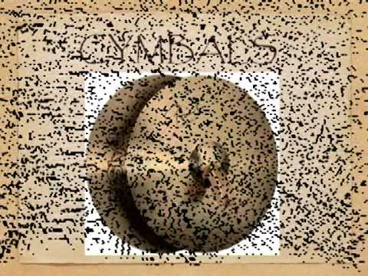

Slide 12
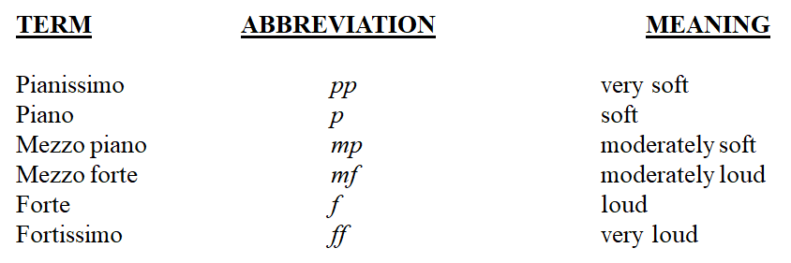
Dynamics
Degree of Loudness or Softness in music.

Slide 13
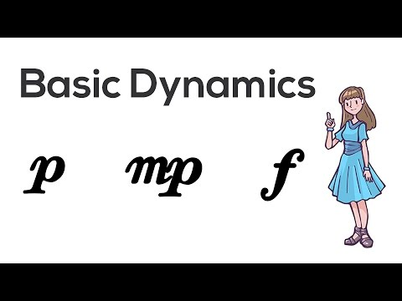

Slide 14
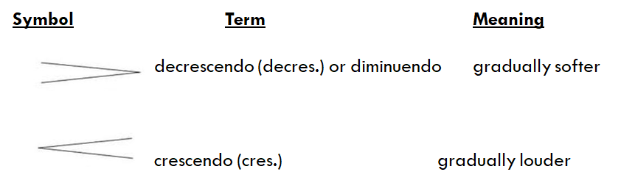
Dynamic symbols

Slide 15
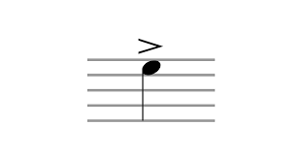

Accent and Syncopation
Accent is a type of dynamic
Accented notes are played stronger than the notes around it.

Slide 16
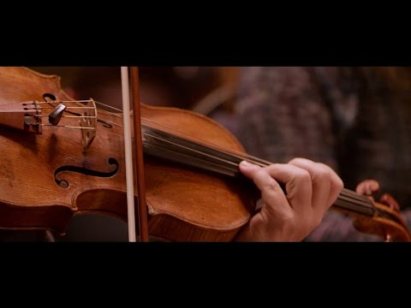

Slide 17
Time in Music
Rhythm
Beat
Meter
Accent and Syncopation
Tempo

Slide 18
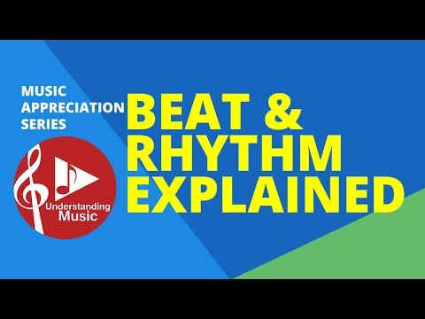
BEAT & RHYTHM

Slide 19
Let’s work together
One group of students stomp your feet consistently in pulse.
The others clap a rhythmical pattern.

Slide 20
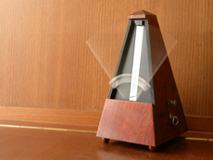
BEAT & RHYTHM
Beats are the consistent pulse throughout a piece of music.
Rhythm are the ordered flow of melody through time.
“In music, rhythm refers to the ordered durations of sounds and silences.”

Slide 21
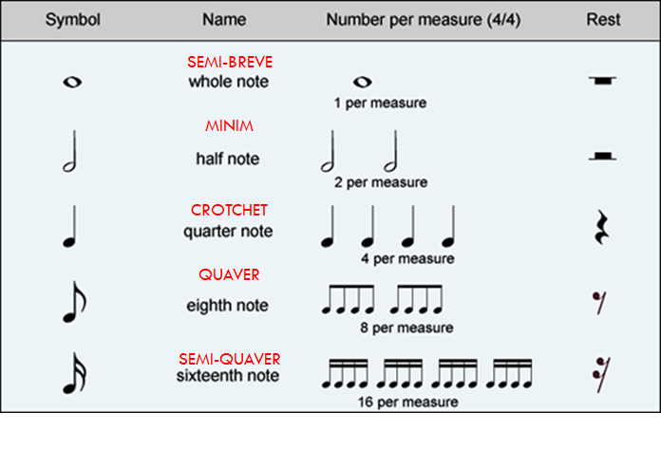
Note values & Rests
Notes:
Practice singing rhythm using hand gestures

Slide 22
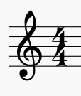

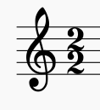




Time Signatures
OR
Four Quarter Beats in a Bar
OR
Alla-breve: 2 Half Beats in a Bar
Questions:

Slide 23
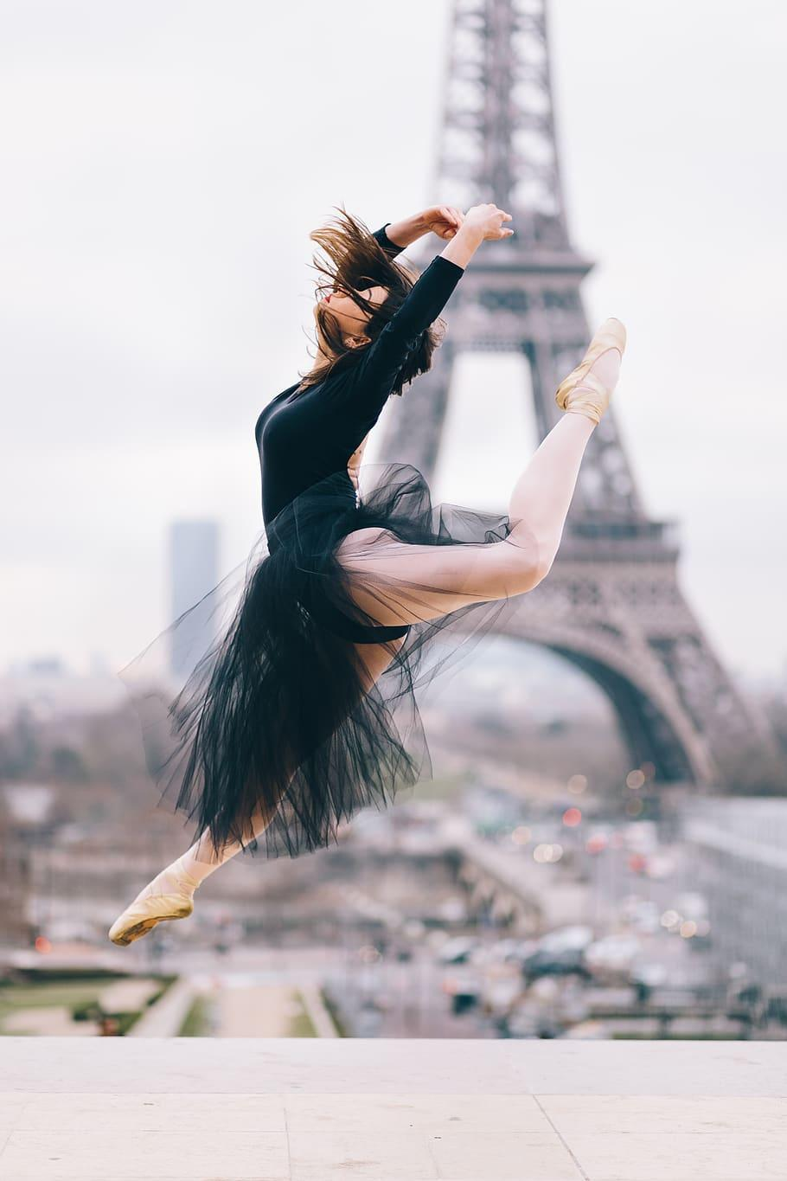
Meter
“A repeated pattern of strong beats plus one or more weaker beats.”
Types of Meter:
Duple Meter
Triple Meter
Quadruple Meter
Quintuple Meter
Sextuple Meter
Septuple Meter

Slide 24
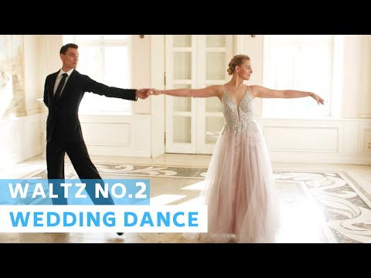

Slide 25
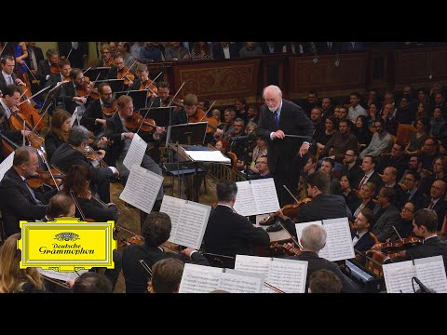

Slide 26
Syncopated Rhythms
when an accented note comes where we normally would not expect one, the effect is known as syncopation
“offbeat”
Syncopation is a characteristic feature of jazz

Slide 27
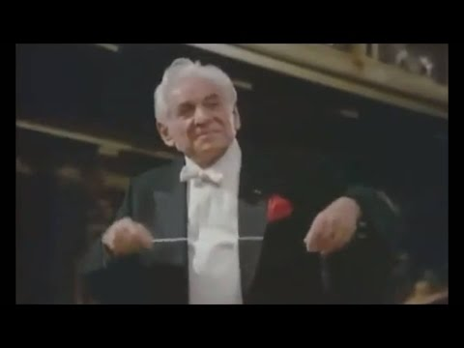

Slide 28
Tempo
Term | Meaning
Largo | Very slow, broad
Grave | Very slow, solemn
Adagio | Moderately slow, a walking pace
Moderato | Moderate
Allegretto | Moderately fast
Allegro | Fast
Vivace | Lively
Presto | Very fast
Prestissimo | As fast as possible
Speed of the Beat
A tempo indication is usually given at the beginning of a piece of music.

Slide 29
Accelerando & Ritardando
Accelerando (Accel…)
Beat getting faster
Ritardando (Rit…)
Beat getting slower

Slide 30
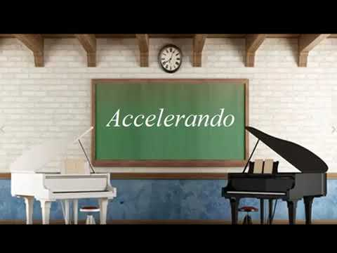

Slide 31

Who composed the serenade "Eine Kleine Nachtmusick"?
ⓘ Start presenting to display the poll results on this slide.
Notes:
📣 This is Slido interaction slide, please don't delete it. ✅ Click on 'Present with Slido' and the poll will launch automatically when you get to this slide.

Slide 32
Who is this composer? (Hint: His most famous work is titled "Ride of the Valkyries")
ⓘ Start presenting to display the poll results on this slide.
Notes:
📣 This is Slido interaction slide, please don't delete it. ✅ Click on 'Present with Slido' and the poll will launch automatically when you get to this slide.

Slide 33
Which of the following is an Opera?
ⓘ Start presenting to display the poll results on this slide.
Notes:
📣 This is Slido interaction slide, please don't delete it. ✅ Click on 'Present with Slido' and the poll will launch automatically when you get to this slide.

Slide 34
What composer is famous for his excessively large hands?
ⓘ Start presenting to display the poll results on this slide.
Notes:
📣 This is Slido interaction slide, please don't delete it. ✅ Click on 'Present with Slido' and the poll will launch automatically when you get to this slide.

Slide 35
Which composer lived in the Classical period?
ⓘ Start presenting to display the poll results on this slide.
Notes:
📣 This is Slido interaction slide, please don't delete it. ✅ Click on 'Present with Slido' and the poll will launch automatically when you get to this slide.

Slide 36
Which composer composed over 50 symphonies?
ⓘ Start presenting to display the poll results on this slide.
Notes:
📣 This is Slido interaction slide, please don't delete it. ✅ Click on 'Present with Slido' and the poll will launch automatically when you get to this slide.

Slide 37
Which instrument below is not part of Malaysian traditional music lineup?
ⓘ Start presenting to display the poll results on this slide.
Notes:
📣 This is Slido interaction slide, please don't delete it. ✅ Click on 'Present with Slido' and the poll will launch automatically when you get to this slide.

Slide 38
What instrument did Louis Armstrong play?
ⓘ Start presenting to display the poll results on this slide.
Notes:
📣 This is Slido interaction slide, please don't delete it. ✅ Click on 'Present with Slido' and the poll will launch automatically when you get to this slide.

Slide 39

Audience Q&A Session
ⓘ
Click Present with Slido or install our Chrome extension to show live Q&A while presenting.
Notes:
📣 This is Slido interaction slide, please don't delete it. ✅ Click on 'Present with Slido' and the questions from your audience will appear when you get to this slide.

Slide 40
End

